Slide 1


Testing Svelte
with Jest
@DmitryVinnik

Slide 2
What do developers like to do the most?
@DmitryVinnik

Slide 3

@DmitryVinnik
dvinnik.dev
Notes:
https://unsplash.com/photos/02MLReRp3I8

Slide 4

@DmitryVinnik
dvinnik.dev
Notes:
https://unsplash.com/photos/2Ts5HnA67k8

Slide 5
More often than not
@DmitryVinnik

Slide 6

@DmitryVinnik
dvinnik.dev
Notes:
https://unsplash.com/photos/m_HRfLhgABo
more often it’s coding

Slide 7
But one day
@DmitryVinnik

Slide 8
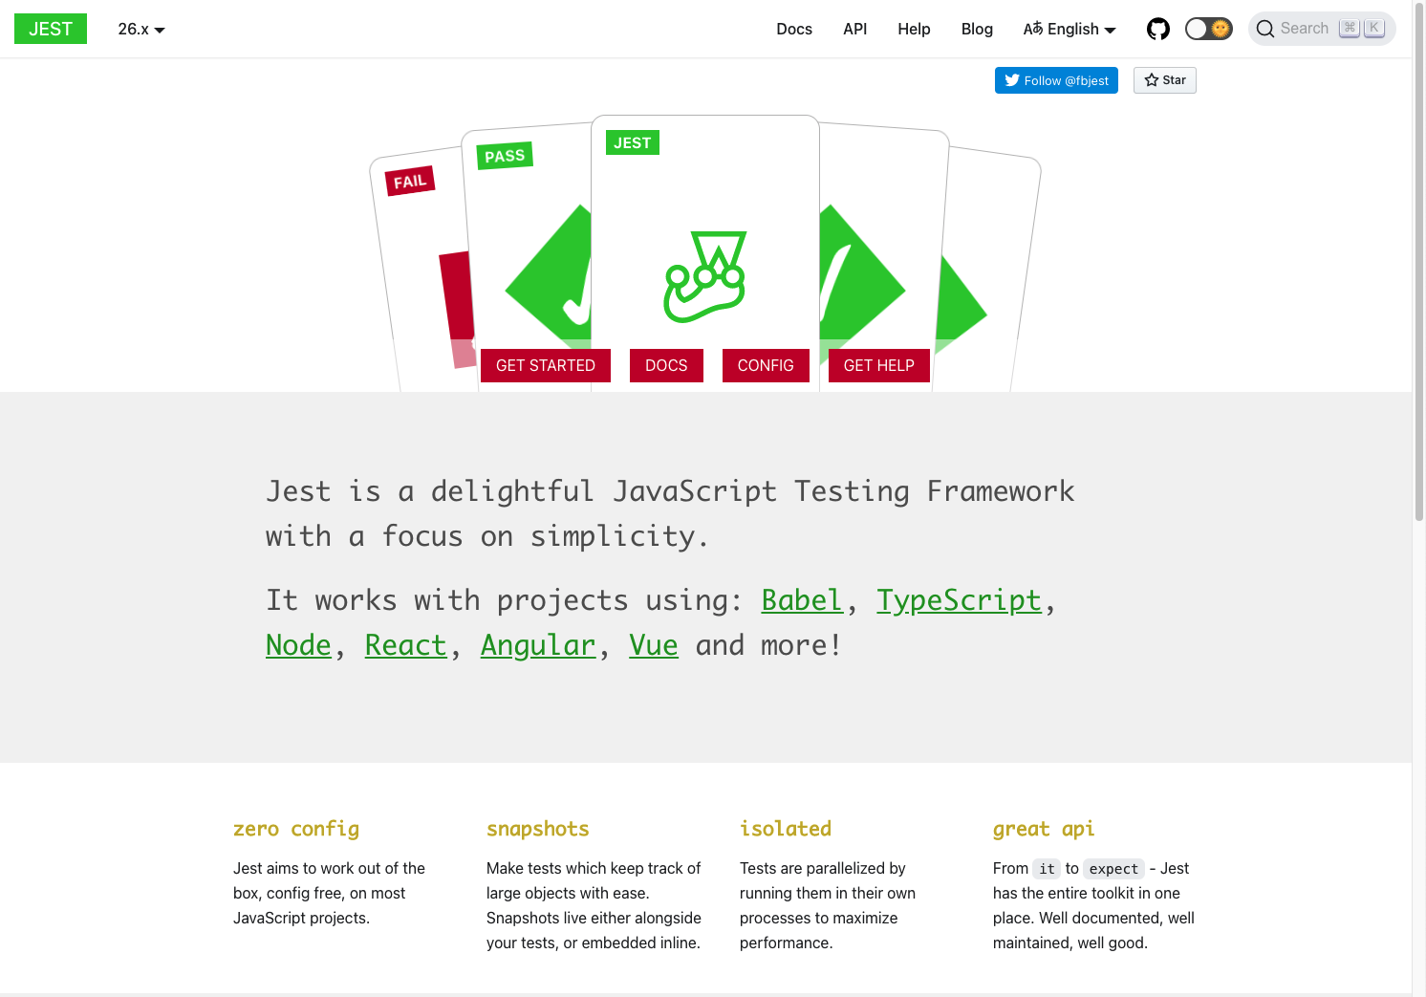
What are our goals?
@DmitryVinnik
dvinnik.dev
Notes:
Testing will become the most favourite thing
and jest is here to help

Slide 9
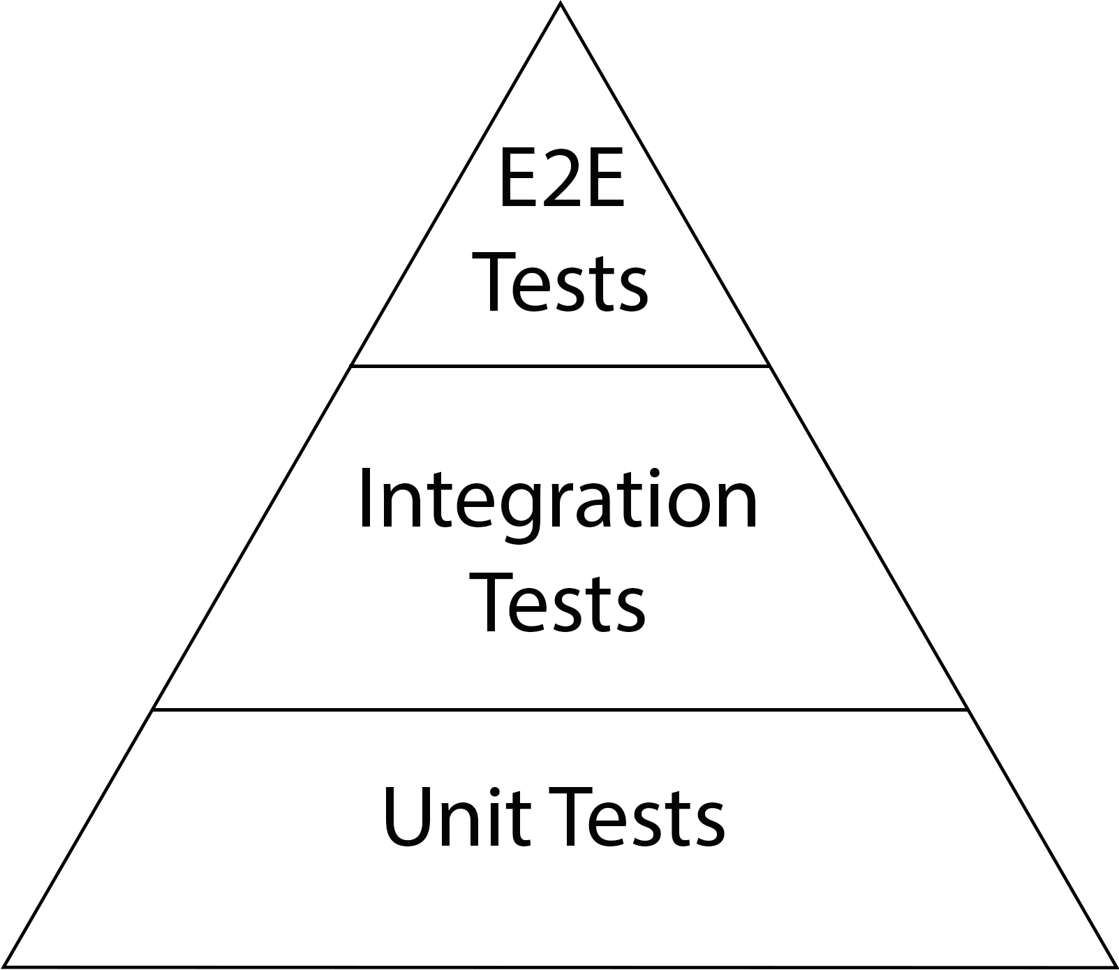
Test Pyramid
@DmitryVinnik
Notes:
Explain width is #tests

Slide 10
Test Pyramid
↓ Cost
@DmitryVinnik
Notes:
Explain width is #tests

Slide 11
Test Pyramid
↑ Speed
↓ Cost
@DmitryVinnik
Notes:
Explain width is #tests

Slide 12
Test Pyramid
↓ Fidelity
↑ Speed
↓ Cost
@DmitryVinnik
Notes:
Explain width is #tests

Slide 13
Test Pyramid
↑ Cost
↓ Fidelity
↑ Speed
↓ Cost
@DmitryVinnik
Notes:
Explain width is #tests

Slide 14
Test Pyramid
↓ Speed
↑ Cost
↓ Fidelity
↑ Speed
↓ Cost
@DmitryVinnik
Notes:
Explain width is #tests

Slide 15
Test Pyramid
↑ Fidelity
↓ Speed
↑ Cost
↓ Fidelity
↑ Speed
↓ Cost
@DmitryVinnik
Notes:
Demo

Slide 16

@DmitryVinnik

Slide 17
Demos
@DmitryVinnik

Slide 18
Demos
Simple DOM Tests
@DmitryVinnik

Slide 19
Demos
Simple DOM Tests
Snapshot Tests
@DmitryVinnik

Slide 20
Demos
Simple DOM Tests
Snapshot Tests
E2E Tests
@DmitryVinnik

Slide 21
Call For Action
@DmitryVinnik
Notes:
Will be sharing slides, github and useful links

Slide 22
Call For Action
Test Your App!
Don’t Overdo it
Contribute Back
@DmitryVinnik
Notes:
Will be sharing slides, github and useful links

Slide 23
About Speaker
Twitter: @DmitryVinnik
Blog: dvinnik.dev
LinkedIn: in/dmitry-vinnik/
Email: dmitry@dvinnik.dev

